Slide 1

IST 782 DATA SCIENCE PORTFOLIO
KWASI MENSAH

Slide 2



Agenda
Introduction
Portfolio Goals
Project Gallery
IST 652 – Scripting for Data Analysis
IST 665 – Natural Language Processing
IST 772 – Quantitative Reasoning for Data Science
IST 718 – Big Data Analytics
Team Project
IST 659 – Data Administration Concepts & Database Management
Conclusion
GitHub Reference Page

Slide 3

Introduction
Master of Science in Applied Data Science at Syracuse University’s School of Information Studies.
Comprehensive program covering various data science disciplines.
Emphasis on technical proficiency, ethical considerations, and practical applications.
Gain understanding of the data science life cycle.
Demonstrate proficiency in R and Python programming languages.
Emphasize teamwork through courses

Slide 4

Portfolio Goals
Demonstrate the ability to collect, store, and access data using relevant technologies.
Showcase actionable insights across various contexts using the data science life cycle.
Apply visualization and predictive models for generating actionable insights.
Utilize programming languages (R & Python) to support insight generation.
Communicate insights effectively to diverse audiences.
Apply ethical considerations in data development, addressing fairness, bias, transparency, and privacy.

Slide 5

IST 652 – Scripting for Data Analysis

Slide 6
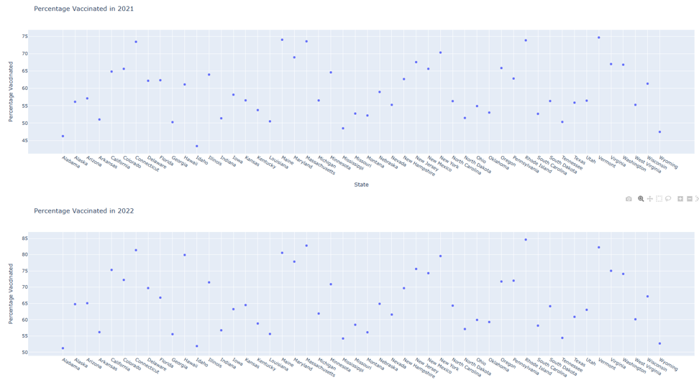
COVID-19 Analysis
Course focused on practical aspects of data science, particularly scripting for data acquisition, access, and transformation.
Emphasis on developing Python scripting skills for data wrangling.
Final project involved a comprehensive analysis of COVID-19 trends, vaccination rates, and their correlation with economic indicators.
Project utilized Python libraries such as pandas, scikit-learn, requests, BeautifulSoup, and GitHub for data handling, exploration, and visualization.

Slide 7
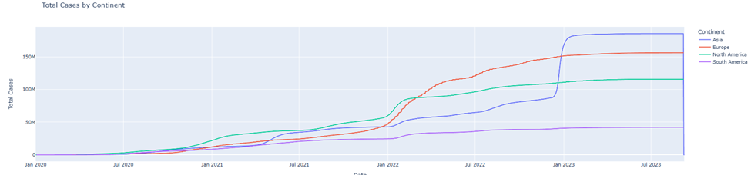
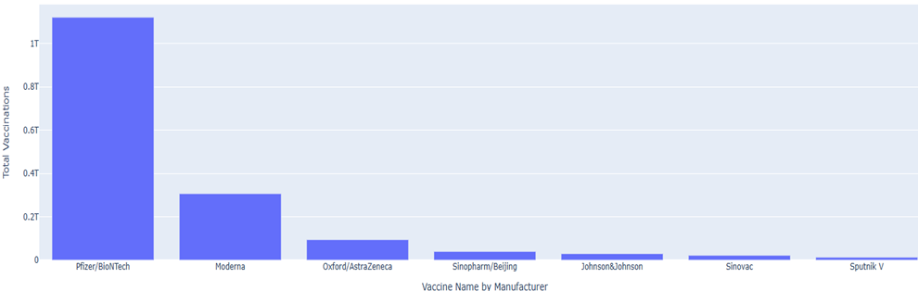
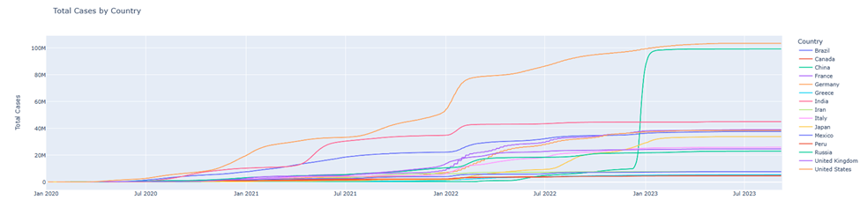
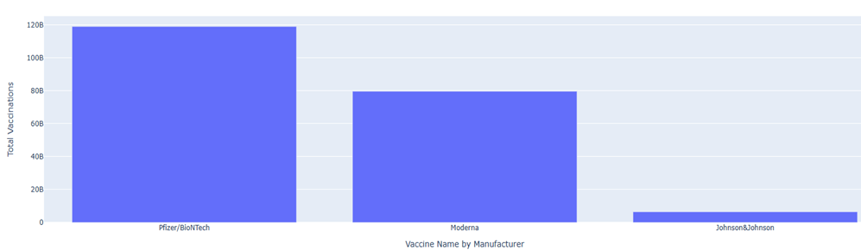

Slide 8
IST 665 – Natural Language Processing

Slide 9
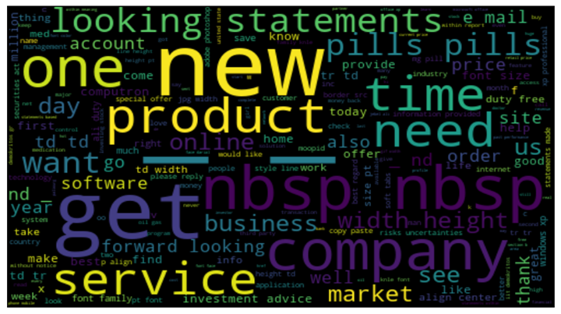
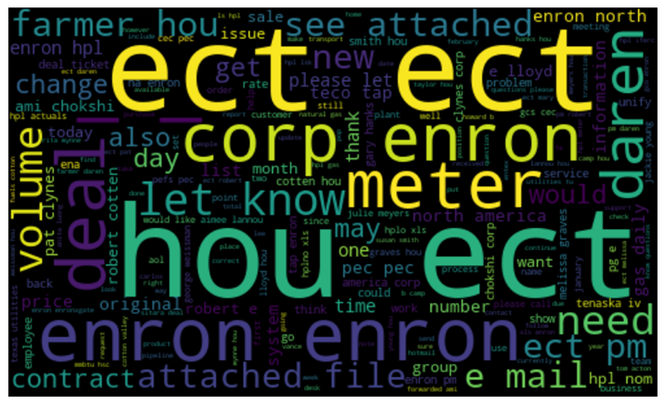
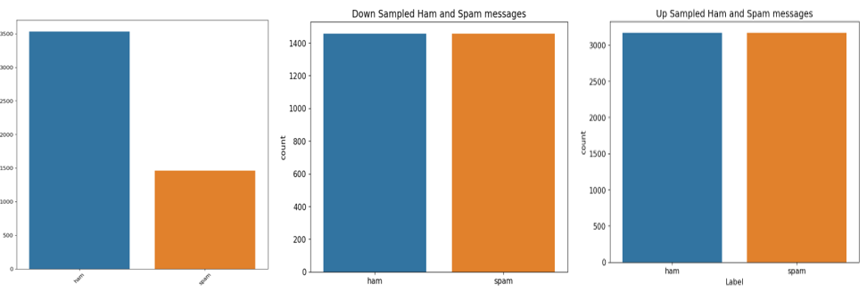
Detection of SPAM in Email
SPAM
HAM
Course focused on the intersection of linguistics and computational techniques in Natural Language Processing (NLP).
Final project involved spam email detection using techniques such as sentiment analysis and subjectivity analysis.
Various classifiers, including Multinomial Naïve Bayes and Support Vector Machine, were trained and evaluated.
Project emphasized data preprocessing techniques, such as tokenization and dataset balancing, to enhance classifier performance.

Slide 10
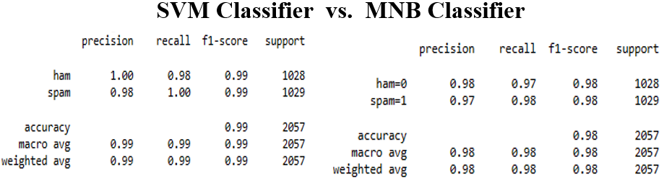
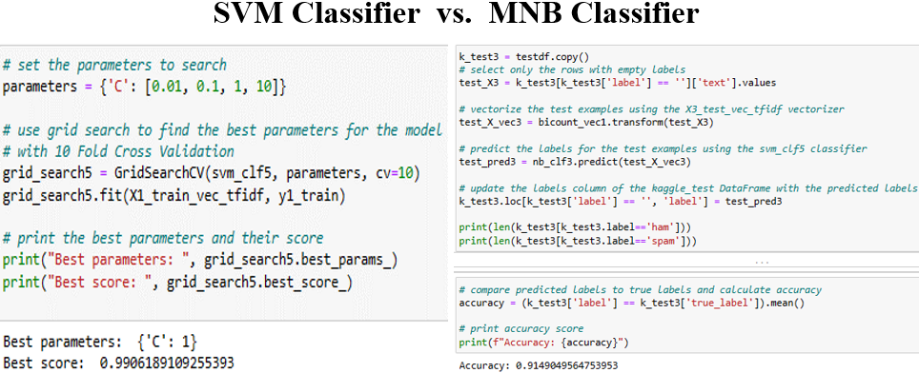

Slide 11
IST 718 Big Data Analytics

Slide 12
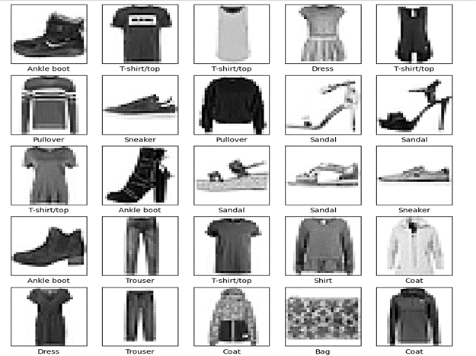
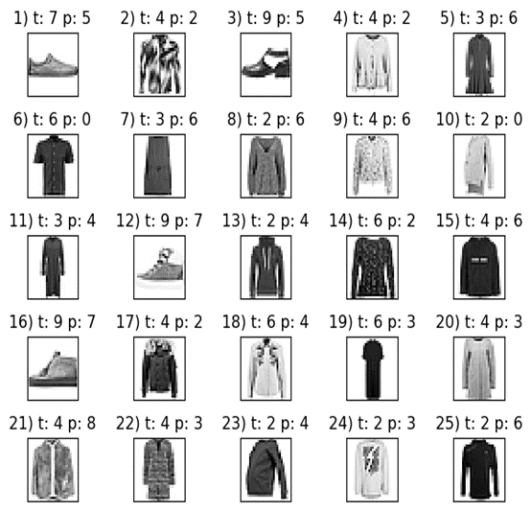
Fashion-MNIST Image Detection
Course introduces analytical processing tools and techniques for obtaining, scrubbing, and interpreting data.
Portfolio project focused on classifying clothing items using machine learning techniques.
Utilized the Fashion MNIST dataset, exploring seven models, including Naïve Bayes, Neural Networks, and Boosted Trees.
Evaluation criteria included accuracy, trade-offs, and computational performance.
Visualizations showcased sample images, misclassified items, and model performance rankings.

Slide 13
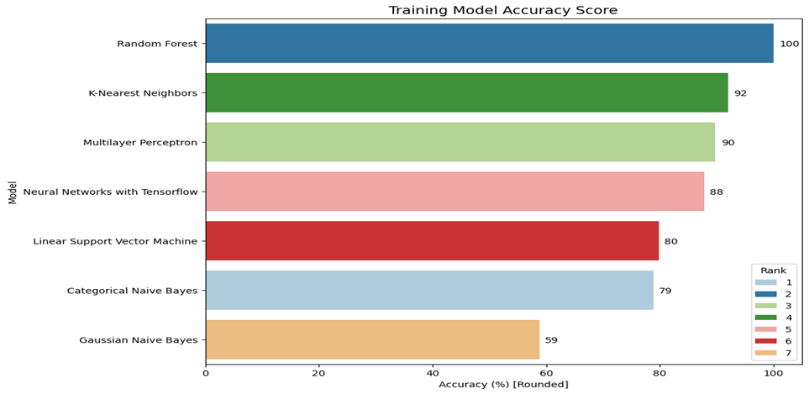
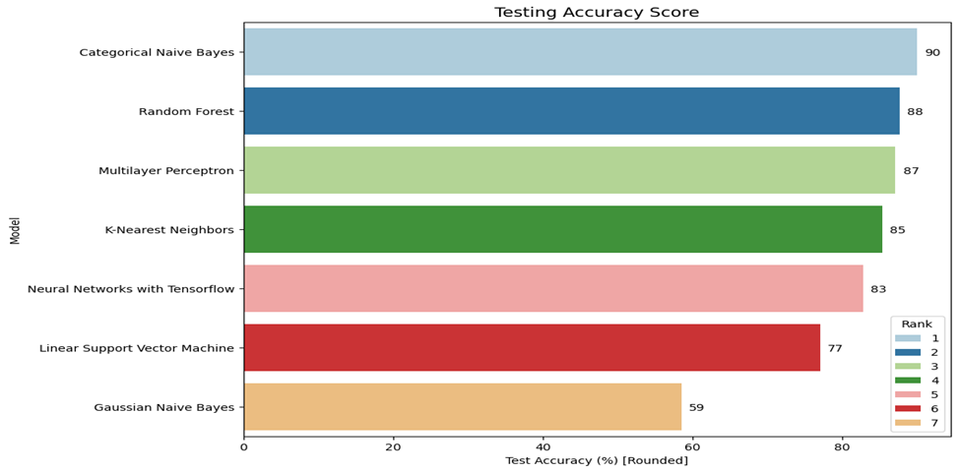
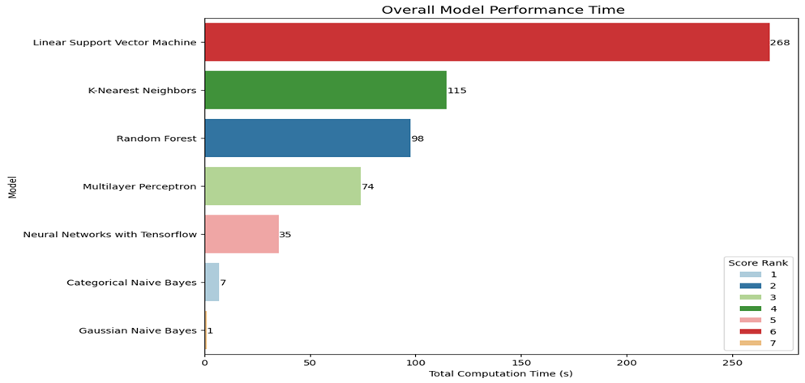

Slide 14
IST 772 Quantitative Reasoning for Data Science

Slide 15
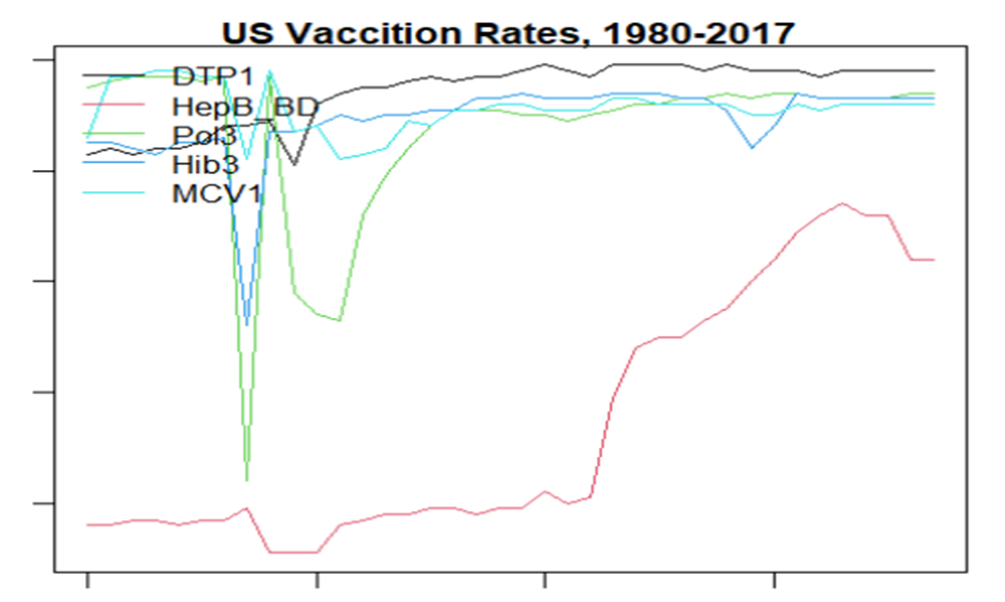
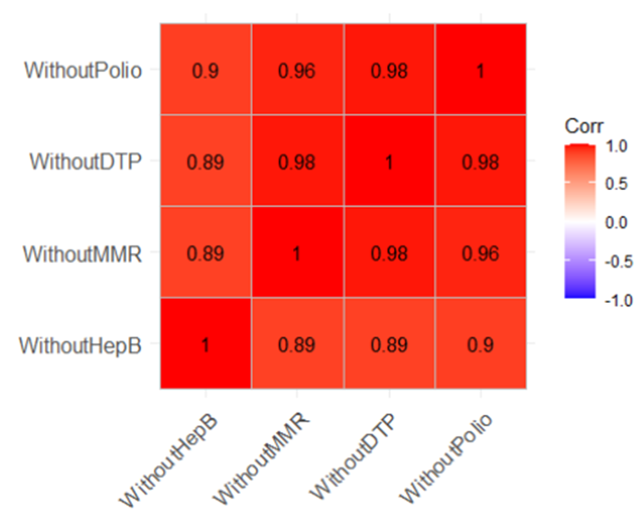

School District Vaccination Analysis
Course equips students with strategies for inferential reasoning about quantitative data.
Portfolio project aimed to provide evidence-based insights on vaccination rates in California school districts.
Analysis involved three datasets, assessing U.S. vaccination trends, reporting proportions, and correlation with individual vaccine rates.
Notable findings included stability in U.S. vaccination rates, reporting disparities between public and private schools, and correlation of California's rates with national averages.

Slide 16
IST 659 – Data Administration Concepts & Database Management

Slide 17
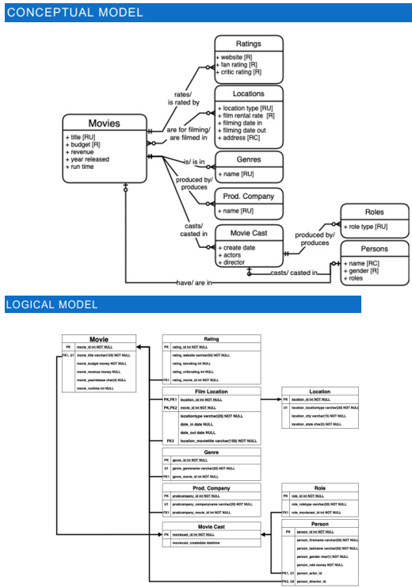
Data Models for "Precise Management Production,"
Course covers fundamentals of database management systems, including data structures, file organizations, and DBMS principles.
Project, titled "Data Models" for "Precise Management Production," aimed at managing movie production information.
Team project involves designing and implementing a functional system with a database.
Objectives included designing a robust database system, replacing an Excel-based system, and enabling efficient data storage and analysis.

Slide 18
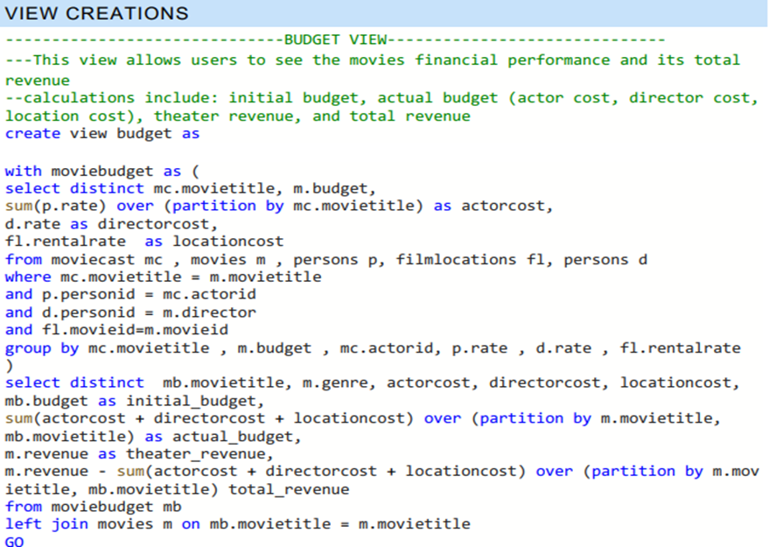
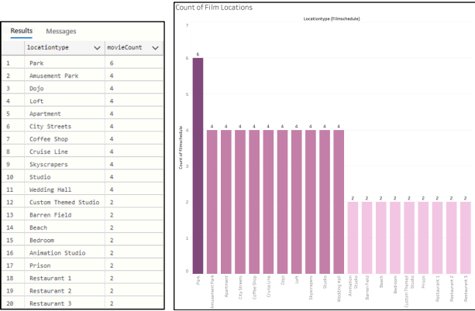
The "budget" view in the database compiles key financial metrics for movies, including initial and actual budgets, alongside theater and total revenues. This allows for a concise evaluation of a movie's financial success by comparing costs with revenue
A bar chart illustrating the frequency of movies filmed at different locations, generated using Tableau and SQL.

Slide 19

Conclusion
Diverse range of projects showcasing proficiency in data science, natural language processing, big data analytics, text mining, and quantitative reasoning.
Demonstrated expertise in data acquisition, cleaning, transformation, and analysis using Python, R, and relevant libraries/frameworks.
Effective application of statistical and analytical techniques to derive meaningful insights from complex datasets.
Collaboration in team projects highlights strong teamwork and system development skills.
Commitment to excellence, innovation, and the practical application of cutting-edge technologies for real-world problem-solving.

Slide 20


Thank You !
Kwasi Mensah
IST 782 - Portfolio
SU-Email: kwmensah@syr.edu
SUID: 897658917

Slide 21
References
IST_782_Portfolio (n.d.). Retrieved from [GitHub link]
KwasMen. (n.d.). IST 782 Portfolio. GitHub. https://github.com/KwasMen/IST_782_Portfolio/tree/main/Portfolio
IST_772_Quantitative_Reasoning_for_Data_Science (n.d.). Retrieved from [GitHub link]
KwasMen. (n.d.). IST 772 Quantitative Reasoning for Data Science. GitHub. https://github.com/KwasMen/IST_782_Portfolio/tree/main/IST_772_Quantitative_Reasoning_for_Data_Science
IST_718_Big_Data_Analytics (n.d.). Retrieved from [GitHub link]
KwasMen. (n.d.). IST 718 Big Data Analytics. GitHub. https://github.com/KwasMen/IST_782_Portfolio/tree/main/IST_718_Big_Data_Analytics
IST_664_Natural_Language_Processing (n.d.). Retrieved from [GitHub link]
KwasMen. (n.d.). IST 664 Natural Language Processing. GitHub. https://github.com/KwasMen/IST_782_Portfolio/tree/main/IST_664_Natural_Language_Processing
IST_659_Data_Administration_Concepts_and_Database_Management (n.d.). Retrieved from [GitHub link]
KwasMen. (n.d.). IST 659 Data Administration Concepts and Database Management. GitHub. https://github.com/KwasMen/IST_782_Portfolio/tree/main/IST_659_Data_Administration_Concepts_and_Database_Management
IST_652_Scripting_for_Data_Analysis (n.d.). Retrieved from [GitHub link]
KwasMen. (n.d.). IST 652 Scripting for Data Analysis. GitHub. https://github.com/KwasMen/IST_782_Portfolio/tree/main/IST_652_Scripting_for_Data_Analysis

